Slide 1

Making a Batch Manually
6.25.24 version 1.0

Slide 2
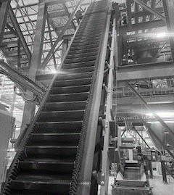
Assumptions and Prerequisite Skills
The computer is on and IntelliBatch 3.0 is open
Supplies Needed
Standard PPE

Slide 3
Preface
This procedure focuses on making one batch at a time. If for any reason you would need to manually make multiple batches quickly you should use the pipelining technique which is how batches are made when all settings are set to “auto”. Pipelining is when all stations are working simultaneously so that once one station finishes up its work required on a batch, that same station can start working on the next batch immediately.

Slide 4
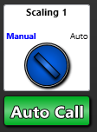
1. Click on the “Manual” text on the “Scaling 1” switch (Figure 1).
Figure 1

Slide 5
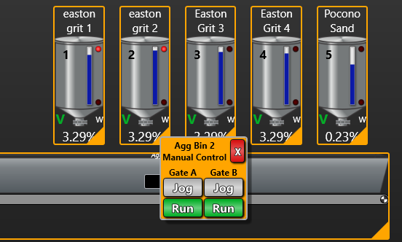
2. Click the orange triangle on one of the first four aggregate bins (Red circle in Figure 2).
Figure 2

Slide 6
3. Click on the run button until the Aggregate Weighbelt has reached about 5000 lbs. (Blue circle in Figure 3). While doing this, switch back and forth between the two gates so that neither gate gets clogged.
4. Click on the jog button (Red circle in Figure 3) until the Weighbelt has reached 5200 lbs.
Figure 3

Slide 7
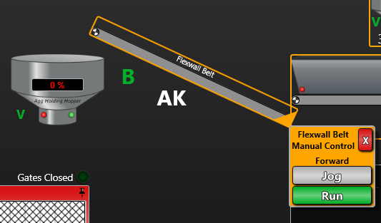
Click on the orange triangle on the “Flexwall belt” icon.
Click the “Run” button under the forward tab (Blue circle in Figure 4).
Figure 4

Slide 8
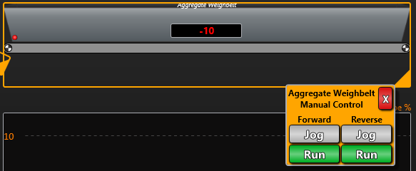
7. Click on the orange triangle on the “Aggregate Weighbelt” icon.
8. Click the “Run” button under the forward tab (Blue circle in Figure 5).
Figure 5

Slide 9
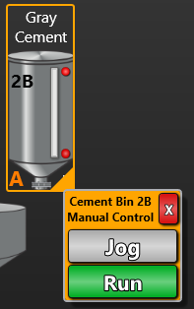
9. Click on the orange triangle on one of the Cement Silos.
10. Click the “Run” button until The cement scale reaches about 640 lbs. (Blue circle in Figure 6).
11. Click and hold the “jog” button until the cement scale reaches 650 lbs. (Purple circle in Figure 6).
Figure 6

Slide 10
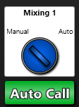
12. Click on the “Manual” text on the “Mixing 1” switch (Figure 7).
Figure 7

Slide 11
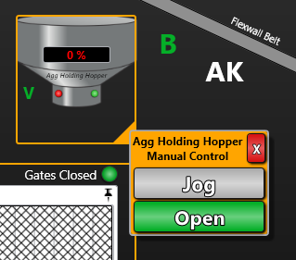
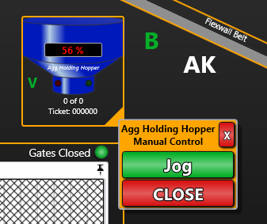
13. Click on the “Agg Holding Hopper” and click “open” (Purple circle in Figure 8a).
14. Wait until the “Aggregate Weighbelt” value is 0 (or close to 0 for a long period of time). Once this happens, click the “Close” button (Purple circle in Figure 8b).
Figure 8a
Figure 8b

Slide 12
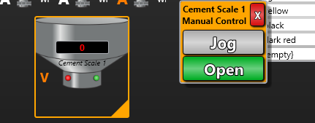
15. Click on the cement scale and click “open” (Purple circle in Figure 9).
16. Wait until the “Cement Scale” value is 0 (or close to it for a long period of time). Once this happens, click the “Close” button.
Figure 9

Slide 13
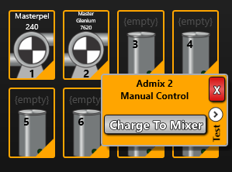
17. Click on the “Master Glenium 7620” icon and press and hold on the “Charge to Mixer” button for 5 seconds (Green circle in Figure 10).
Figure 10

Slide 14
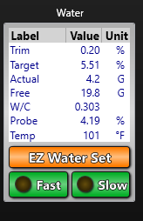
18. Click on the “fast” button on the water table and hold the button until the probe is about .2% from the discharge moisture of the last batch (Red circle in Figure 11).
Figure 11

Slide 15
19. Click on the “slow” button on the water table and hold the button until the probe reaches the discharge moisture of the last batch (Red circle in Figure 12).
Figure 12

Slide 16
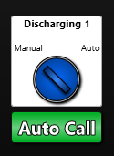
20. Click on the “Manual” text on the “Discharging 1” switch (Figure 13).
Figure 13

Slide 17
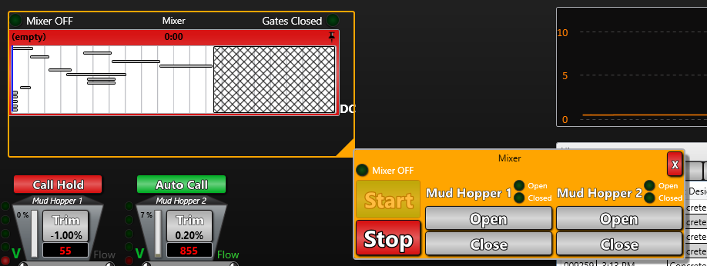
21. Click on the “Manual” text on the “Discharging” switch.
Click on the orange triangle on the Mixer icon. Press and hold the “open” button under “Mud Hopper 2” until the light next to the “open” label lights up (Blue circle in Figure 14).
22. Watch the “Mud Hopper 2” weight value. Once you see the value no longer going up, press and hold the “close” button under “Mud Hopper 2” until the light next to the “close” label lights up (Purple Circle in Figure 14).
Figure 14

Slide 18
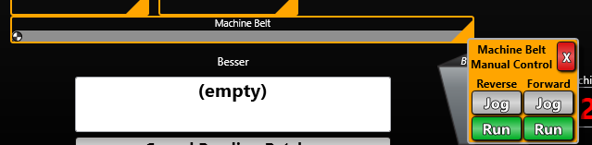
23. Click on the orange triangle under the “Machine Belt” icon. Click the “Run” button under the forward tab (Blue circle in Figure 15).
Figure 15

Slide 19
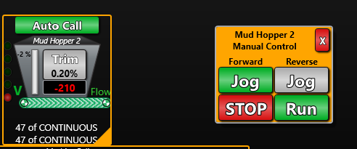
24. Click on the orange triangle under the “Mud Hopper 2” icon. Click the “Run” button under the forward tab. Your screen should look like Figure 16.
Figure 16

Slide 20
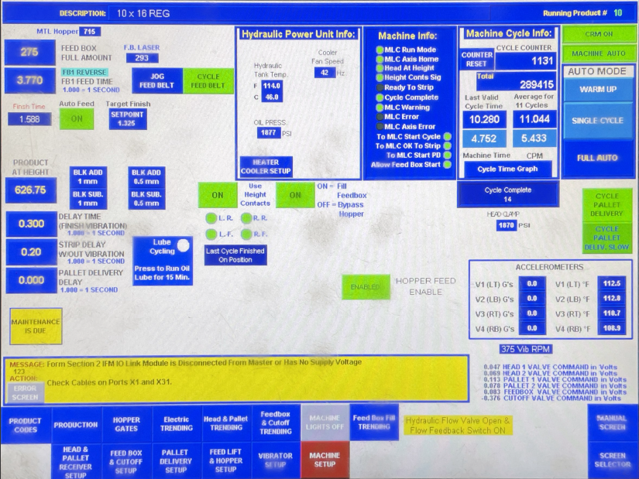
25. Watch the Feed Belt hopper and make sure the “MTL Hopper” value is not over 800 (orange circle in Figure 17). Once the value hits 700, Stop both the machine belt and Mud Hopper belts until the hopper is close to empty again.
26. Repeat steps 22-23 until the batch has gone through the block machine.
Figure 17

